Slide 1
Simple Linear Regression Between Two Variables

Slide 2
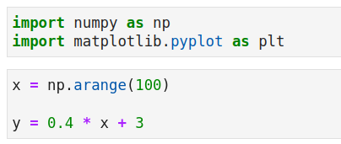
Two Variables With Linear Relation
M or slope is: 0.4
C or intercept is: 3

Slide 3
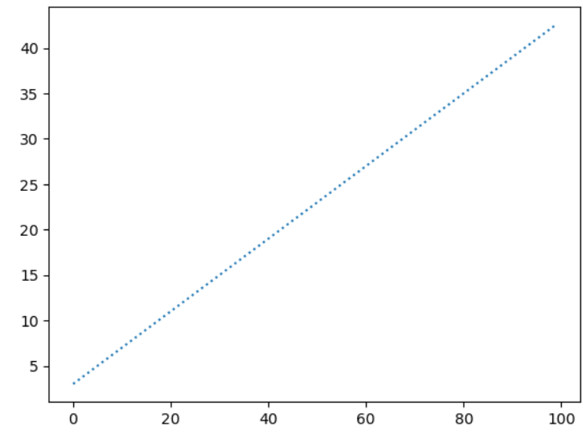
Plot for variables we saw in the last slide

Slide 4
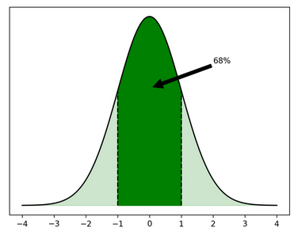
In real situations, your data comes with noise that follows a normal distribution
Brief about Normal Distribution:
The normal distribution is one of the most useful probability distributions because it models many natural phenomena very well. With NumPy, you can create random number samples from the normal distribution.
This distribution is also called the Gaussian distribution or simply the bell curve. The latter hints at the shape of the distribution when you plot it:
The normal distribution is symmetrical around its peak. Because of this symmetry, the mean of the distribution, often denoted by μ, is at that peak. The standard deviation, σ, describes how spread out the distribution is.
If some samples are normally distributed, then it’s probable that a random sample has a value close to the mean. In fact, about 68 percent of all samples are within one standard deviation of the mean.
You can interpret the area under the curve in the plot as a measure of probability. The darkly colored area, which represents all samples less than one standard deviation from the mean, is 68 percent of the full area under the curve.

Slide 5
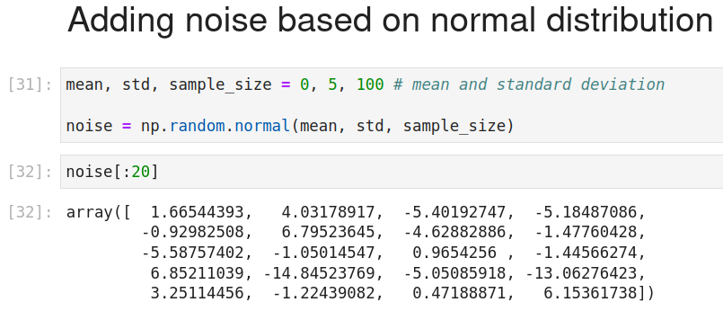

Slide 6
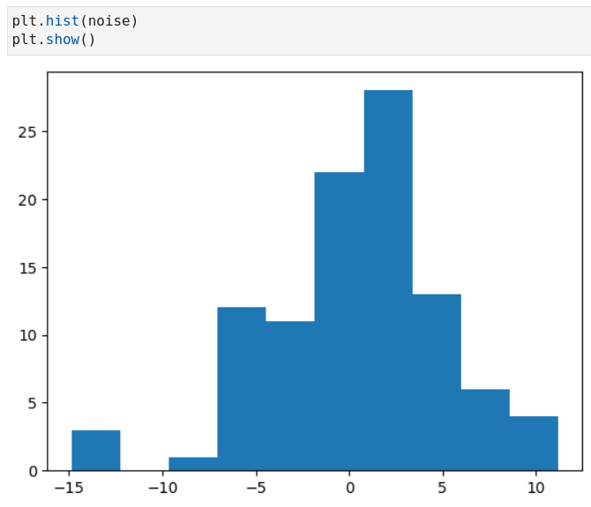

Slide 7
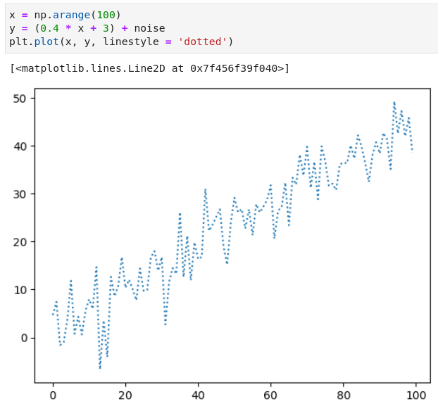
Two Linearly Related Variables Forming Pattern Like a Time Series

Slide 8
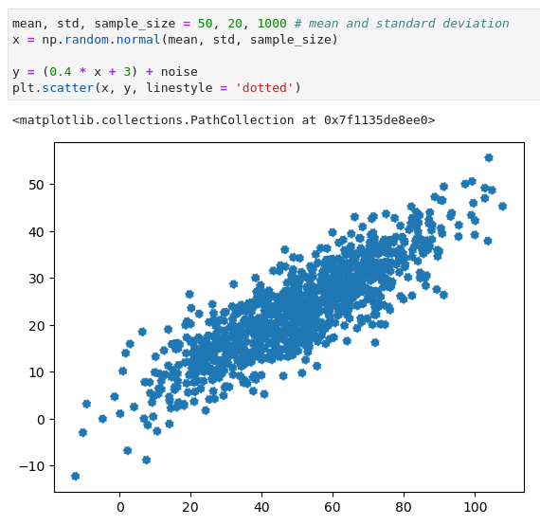
Two Linearly Related Variables Forming Pattern Like a Blob

Slide 9
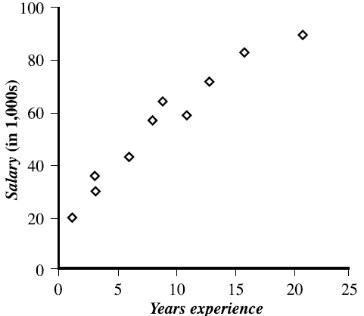
Two perimeters we learn during Linear Regression
Linear Regression is only about learning two parameters:
1) Slope
2) Intercept

Slide 10
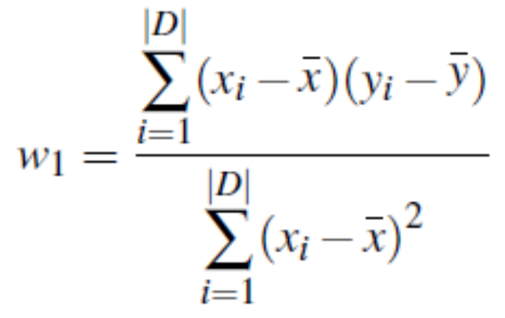
Equation we are trying to learn is: y = w0 + w1 * x
Slope:
Intercept:

Slide 11
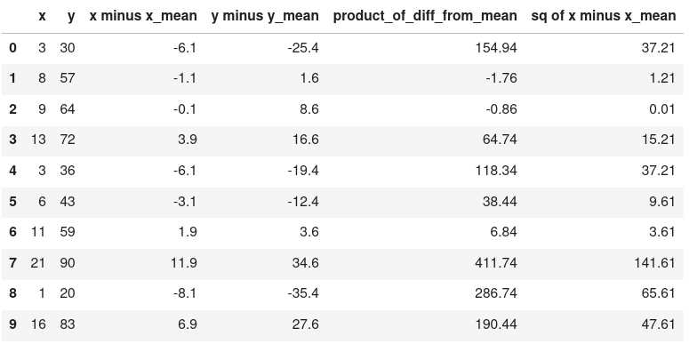

Slide 12
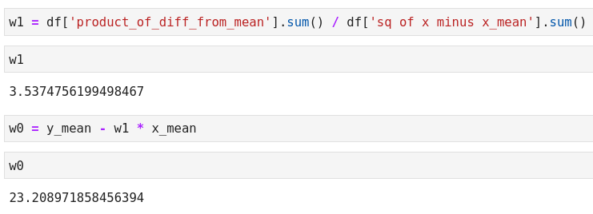
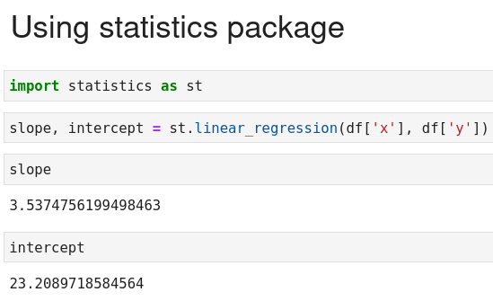
Linear Regression Using Pandas and Statistics Package

